Slide 1

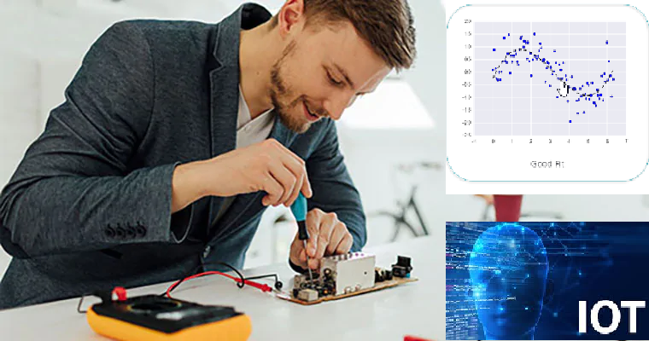



Wearable Devices and Computer Vision
Wednesday, July 06, 2020
Head Instructor: Jose Luis Ramirez Herran
TA’s: Souleymane Konate and Ricardo Villamil

Slide 2
Summary from past two weeks
Students are getting the hardware
Get started with the Sensor Tile development
Introduce the basic signal processing concepts
Introduce image processing – basic image operations
Last Class:
Tutorial 1 Troubleshooting
Introduction to Machine Learning and Human Activity Recognition
Numpy, Pandas, Matplotlib and Scikit learn.

Slide 3
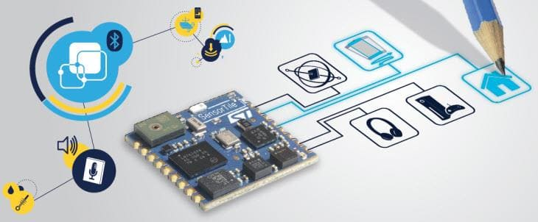
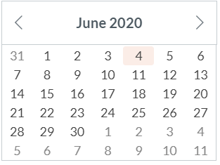
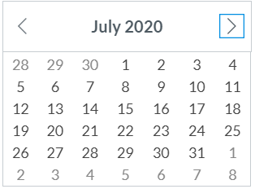
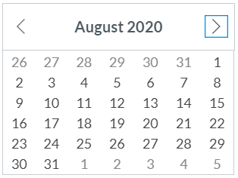
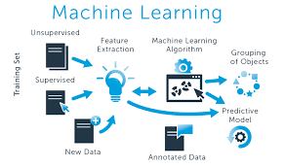
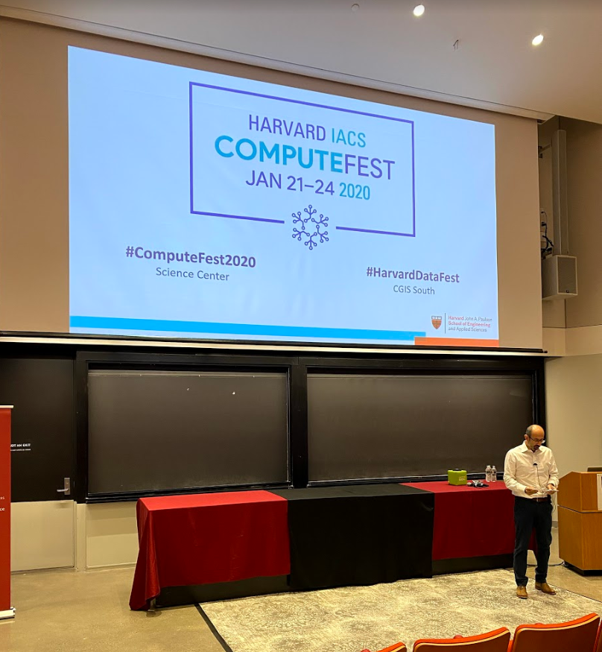
Calendar summer 2020
Mondays and Wednesdays 6:30 pm – 9:30 pm
Wearable Devices and Computer Vision
Project
presentations
Su M Tu W Th F S
SW+HW Setup.+ Basic Tutorials

Slide 4

Today’s Lecture
Break
7:40 pm – 7:50 pm
Break
8:40 pm – 8:50 pm
Part 1
Part 2
Python for:
Linear and Logistic Regression using Python
Questions
Part 3
Optimizing of the Number and Placements of Wearable IMUs for Automatic Rehabilitation Recording
Questions?
Projects and Teams
Summary
Regression Algorithms by Souleymane Konate
6:30 pm – 7:50 pm
7:50 pm – 8:40 pm
8:50 pm – 9:30 pm

Slide 5
Break
7:30 pm – 7:40 pm
6:30 pm – 7:30 pm
Part 1
Summary
Regression Algorithms by Souleymane Konate

Slide 6
Break
7:30 pm – 7:35 pm
Break
9:10 pm – 9:15 pm
Part 1
Introduction
Part 2
Hands-on Activity
Part 3
Office Hours
Questions?
Discussion
Projects + teams
Logistics
6:30 pm – 7:30 pm
7:35 pm – 8:35 pm
9:15 pm – 9:30 pm

Slide 7
Office hours
emails TA's:
sok462@g.harvard.edu
ricardo_villamil@fas.harvard.edu
Calendly me:
https://calendly.com/jlr682/wearable-devices-final-project

Slide 8
piazza
If you haven’t done so already, please take a couple of seconds and submit your location now in Canvas.
Please sign-up for piazza now.
Piazza2020Summer_Access_Codes:
Wearables code:
dgmds1434484
Class Signup Link:
piazza.com/extension.harvard/summer2020/dgmds1434484
Thanks

Slide 9
Bonus materials: Videos from summer 2019
As an excellent resource we will provide this year is the access to the Lectures from the summer of 2019.
During that semester, we focused a lot in the details about the software and the tutorials.
The video module is an excellent resource that could help you to answers many questions while you are experimenting with the machine learning embedded system: Sensor Tile. You can do this learning independently at your own pace in your own time-zone.

Slide 10
Troubleshooting tutorials in canvas
We have very effective office hours so far and we can show some videos were we solved specific problems related with the tutorials. Please take a look in Canvas and we hope this videos help you to get started with the sensorTile curriculum. They will be published into the canvas modules.

Slide 11
Polls
Have you look at the videos from the summer 2019?
Do you have a sensorTile kit plus accessories?
Were you able to finish Tutorial 1?
Have you being able to setup your computer with anaconda?
Have you being able to run Ricardo's Jupyter Notebook?
Do you have a team?
Do you have a project?

Slide 12
Scikit learn, linear regression and logistic regression
Find Python Notebooks

Slide 13
Questions?

Slide 14
Today’s Lecture
Break
7:40 pm – 7:50 pm
Break
8:40 pm – 8:50 pm
Part 1
Part 2
Python for:
Linear and Logistic Regression using Python
Questions
Part 3
Optimizing of the Number and Placements of Wearable IMUs for Automatic Rehabilitation Recording
Questions?
Projects and Teams
Summary
Regression Algorithms by Souleymane Konate
6:30 pm – 7:50 pm
7:50 pm – 8:40 pm
8:50 pm – 9:30 pm

